Slide 1

The Random Projection Outlier Ensemble
Caroline Freyer
Supervisor: Dr. David Tax
Source: almondemotion.com

Slide 2

II
76
Pulse
HR
79
120
50
Pleth
SpO
84
Temp
100
37.3
90
40.1
Resp
RR
18
36.9
30
8
Auto 10 min
NBP
121/82
(89)
160
10:30 122/81 (89)
10:40 121/81 (90)
10:50 120/82 (89)
11:00 123/80 (89)
90
Source: istockphoto.com

Slide 3
II
--
Pulse
HR
--
---
--
Pleth
SpO
84
Temp
100
37.3
90
40.1
Resp
RR
18
36.9
30
8
Auto 10 min
NBP
---/--
(--)
160
10:30 122/81 (89)
10:40 121/81 (90)
10:50 120/82 (89)
11:00 123/80 (89)
90
Source: istockphoto.com
Beep!

Slide 4
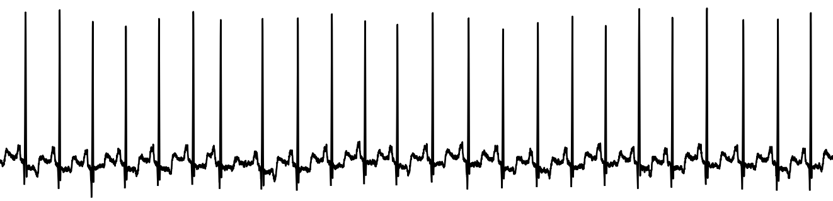
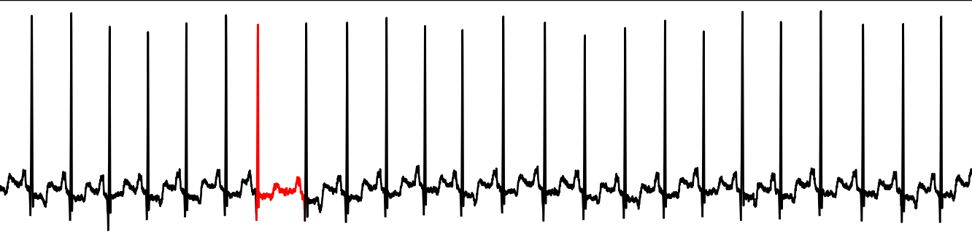
Can you find the outlier?

Slide 5
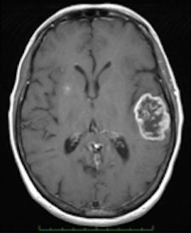
Why would an outlier be important to detect?
Premature heartbeats → Cardiomyopathy
Spike in temperature → Infection
Irregular breathing patterns → Apnea
Anomalous MRI image → Malignant tumor
Irregular credit card transition → Theft
Peculiar reading from a spacecraft sensor → Fault in component
Outliers hold valuable information!
Source: istockphoto.com
Source: cancer.gov

Slide 6
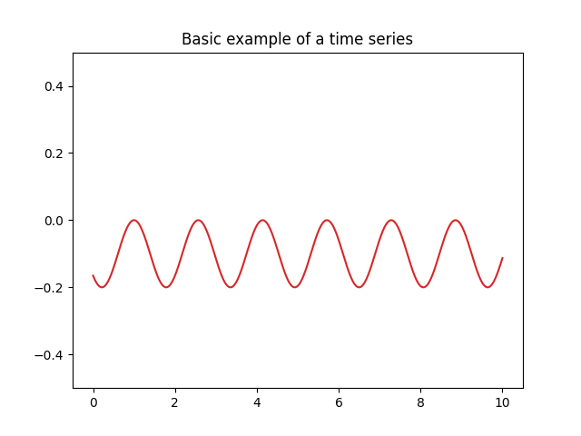
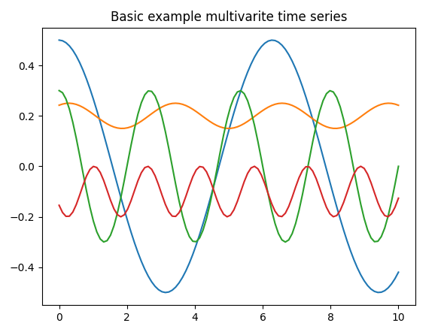
Time series
Dataset with
Chronological ordering of data points
Temporal continuity = high correlation between successive instances.
Multivariate time series
Time series are correlated as well: spatial dependency.
Why time series? Large part of the data collected today is time series data (Wu, 2017)
y
x
Notes:
Find outliers in the time series!

Slide 7
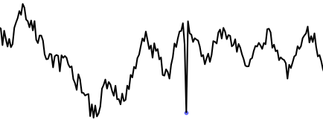
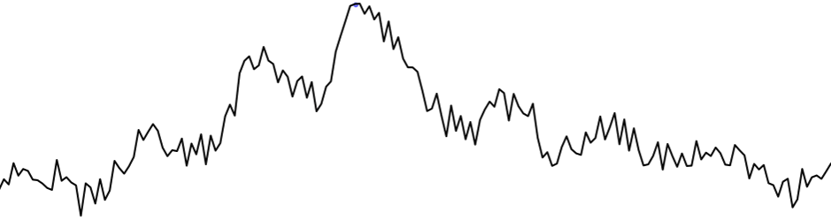
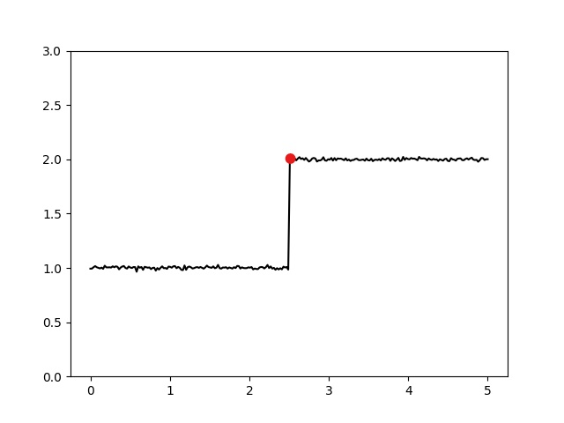
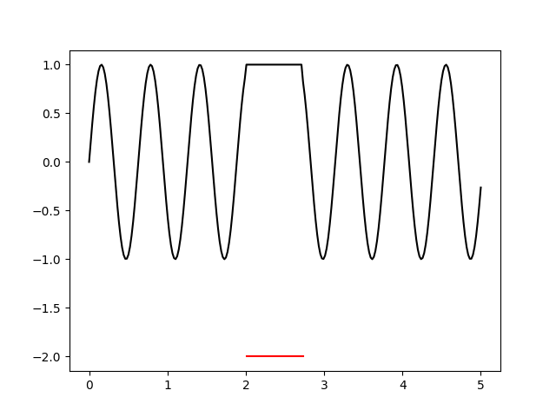
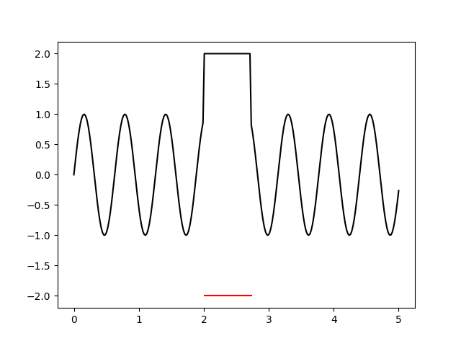
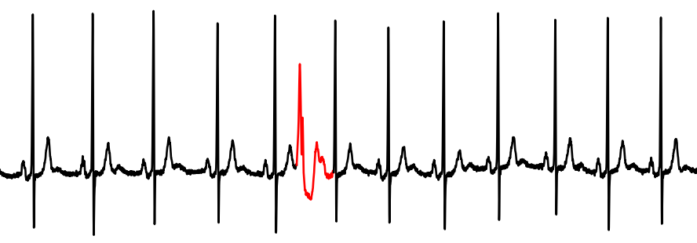
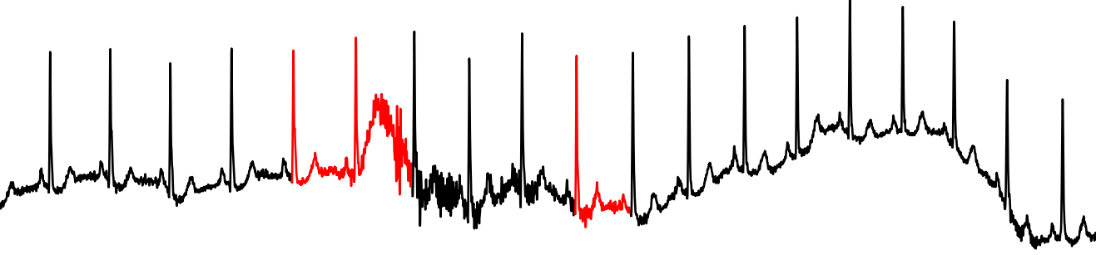
Variety of outliers and input data

Slide 8
We need an accurate and efficient outlier detection method that generalizes across different types of time series data.

Slide 9
Challenges
C1. Variety in types of outliers.
C2. Variety of input data.
C3. Dependencies in time series data.
C4. Noisy and finite dataset.
C5. High run-time complexity.
C6. Trade-off between level of supervision and accuracy.
…… No given method will be able to solve outlier detection problems perfectly (Aggarwal, 2017).

Slide 10
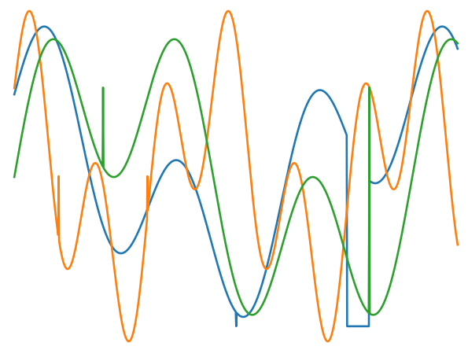
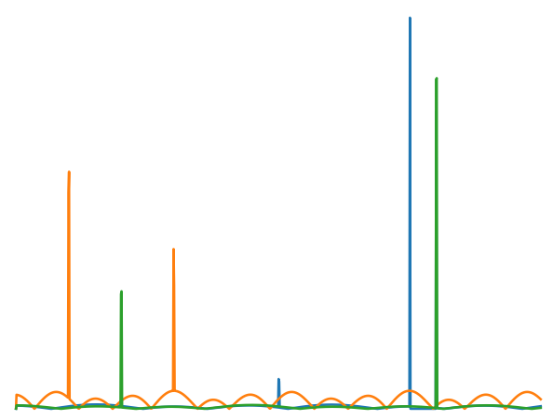
The Random Projection Outlier Ensemble
What is an ensemble?
Advantages:
Popular technique for improving accuracy ^{(C6)}
Different detectors highlight different outliers^{(C1)}
Different detectors perform better on different datasets^{(C2)}
Alleviates base detectors’ sensitivity to parameters ^{(C2)}
Team
work
Base detectors
Aggregation
Final result
Data and its derivatives

Slide 11
The Random Projection Outlier Ensemble (RPOE)
Base detectors
WINNOW
Aggregation
Component
scores
Final outlierness scores
Data and its derivatives
1
2
3
Data
Base detectors
Aggregation

Slide 12
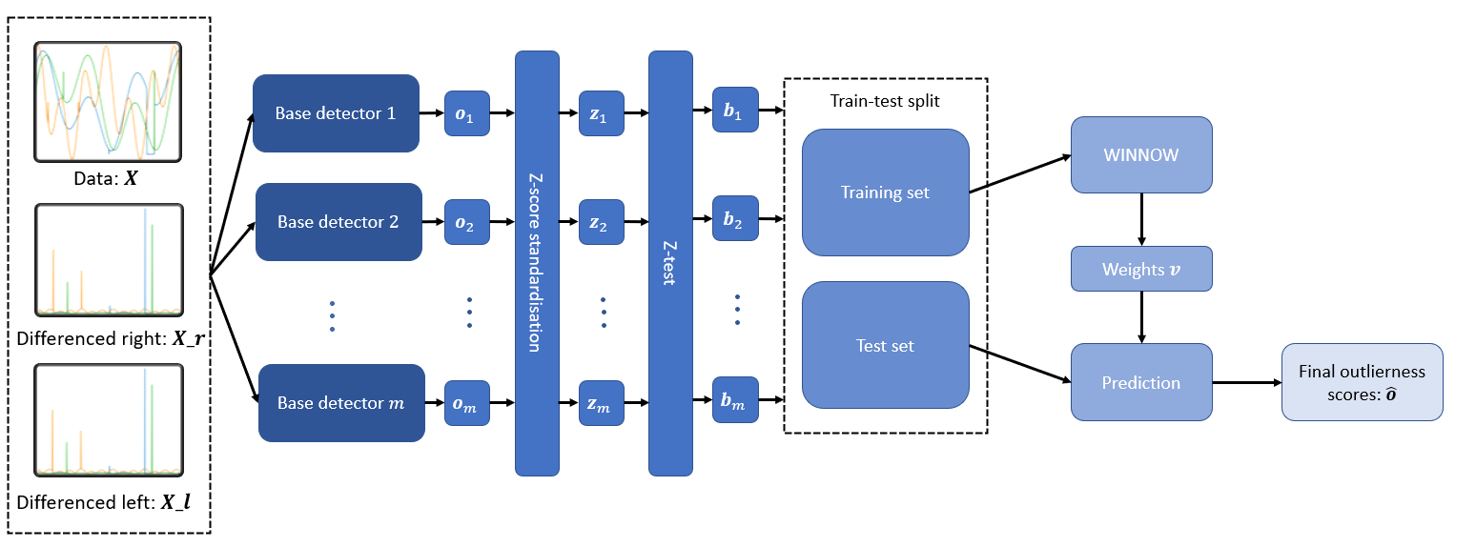
RPOE: Data
1
Three data variants
Original time series
Differenced time series from the right
Differenced time series from the left
Differencing highlights abrupt changes in temporal continuity. ^{(C1,C3)}

Slide 13
RPOE: Base detectors
2
Random Projection (RP) method
Mean Projection (MP) method
Different parameter settings: parameters are sampled from reasonable ranges.
High sensitivity to parameter choice → Difficult to determine sampling ranges, needed user input.

Slide 14







The RP method
2
$$ℓ×d$$
$$R$$
$$w′(t)$$
$$x(t)$$
$$R^{T}$$
$$\hat{w}(t)$$
$$w(t)$$
Original Problem Space
Random lower-dimensional space

Slide 15

The RP Method
2
The outlierness score for $x\left(t\right)$is
$$o\left(t\right)={\left\|w\left(t\right)−\hat{w}\left(t\right)\right\|}^{p}$$
where $p∈ℕ.$

Slide 16
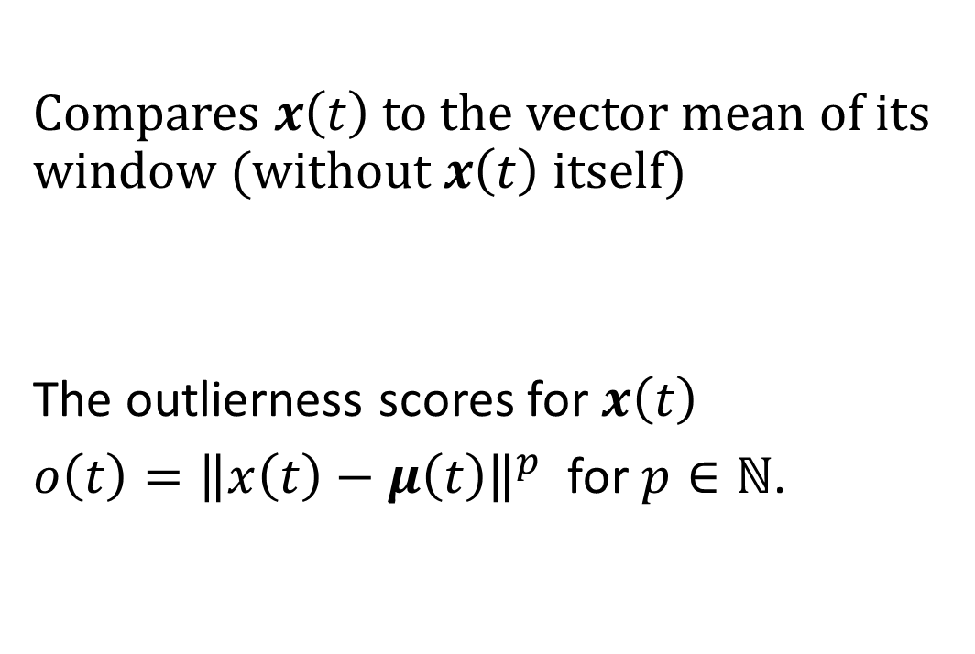



The MP method
2
Compares $x\left(t\right)$ to the vector mean of its window (without $x\left(t\right)$itself)
The outlierness scores for $x\left(t\right)$
$o\left(t\right)={\left\|x\left(t\right)−μ\left(t\right)\right\|}^{p}$for $p∈ℕ$.
$$x(t)$$
$$w\left(t\right)/x(t)$$
$$μ(t)$$

Slide 17
Why these base detectors?
2
Advantages:
Decouples method from dataset dimensionality^{(C2)}
Considers context of point to capture dependencies^{(C3)}
Reconstruction-based method: Lowest dataset size requirements ^{(C4)}
Efficient^{(C5)}

Slide 18
RPOE: Aggregation
3
RP and MP methods’ sensitivity to parameter choice methods → Many irrelevant components
→ Supervision
WINNOW is supervised and requires binary matrix as input.
Train test split
Binarisation
WINNOW aggregation
Binary training set
WINNOW
Aggregation
Final outlierness scores
Binary test set

Slide 19












RPOE: train test split
3
$$o_{1}(1)$$
...
$$o_{1}(t)$$
...
$$o_{1}(n)$$
Information leakage
Three splits
Before binarisation.
Train test split
Training set
...
...
...
$$o_{j}(1)$$
...
$$o_{j}(t)$$
...
$$o_{j}(n)$$
Test set
...
...
...
$$o_{m}(1)$$
...
$$o_{m}(t)$$
...
$$o_{m}(n)$$
1
2
3
$$[t_{0},t_{1}]$$
$$[t_{1},t_{2}]$$
$$[t_{2},t_{3}]$$

Slide 20






RPOE: Binarisation
3
$z$-test to binarise.
Binary training set
Z-test
Binary test set
$$z_{j}\left(t\right)=\frac{o_{j}\left(t\right) −{\overline{o}}_{j}}{σ_{j}}$$
outliers (1)
normal (0)
outliers (1)
$$α=0.05$$
$$−1.96$$
$$0$$
$$1.96$$

Slide 21
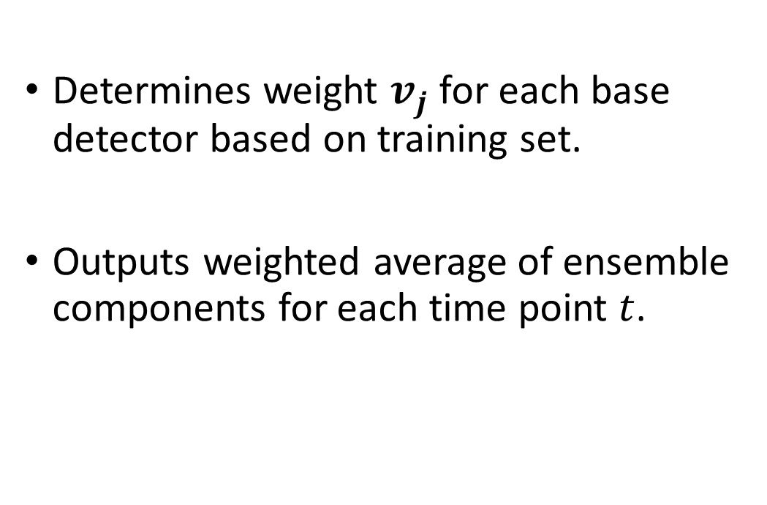
Random Projection Ensemble: WINNOW
3
Determines weight $v_{j}$ for each base detector based on training set.
Outputs weighted average of ensemble components for each time point $t$.
Binary training set
WINNOW
WINNOW
Aggregation
Final outlierness scores
Binary test set

Slide 22

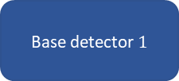



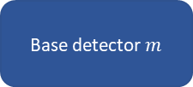

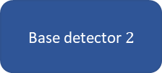

RPOE Overview
Base detector $1$
$$o_{1}$$
Train-test split
Training set
Binary training set
Data: $X$
WINNOW
Aggregation
Base detector $2$
$$o_{2}$$
Z-test
Final outlierness scores
Test set
Differenced right: $X_r$
Binary test set
Base detector $m$
$$o_{m}$$
Differenced left: $X_l$
1
2
3

Slide 23
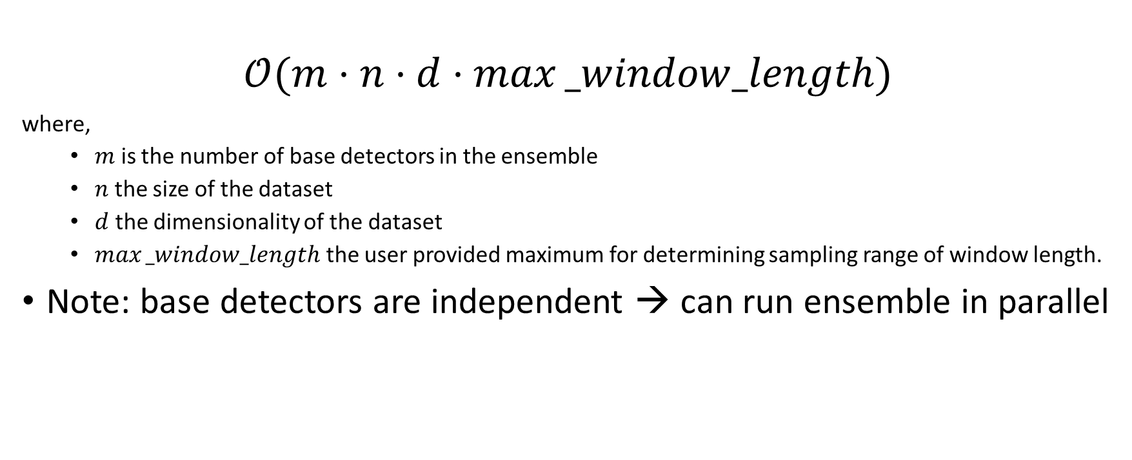
Runtime
$$𝒪(m⋅n⋅d⋅max⁡_window_length)$$
where,
$m$ is the number of base detectors in the ensemble
$n$ the size of the dataset
$d$ the dimensionality of the dataset
$max⁡_window_length$ the user provided maximum for determining sampling range of window length.
Note: base detectors are independent → can run ensemble in parallel
$$𝒪(n⋅d)$$

Slide 24
Evaluation
?
Difficult:
Scarcity of labelled datasets.
Limited by report findings:
Synthetic datasets or not publicly accessible.
Premature methods.
Code unavailable.
Used four publicly available datasets.
Low dimensionality (1D and 2D).
Similar.
Lots of pre-processing.
Unreliable labels.
Naïve Classifier:
Fits multivariate Gaussian on windows.
Extensive hyperparameter tuning.

Slide 25
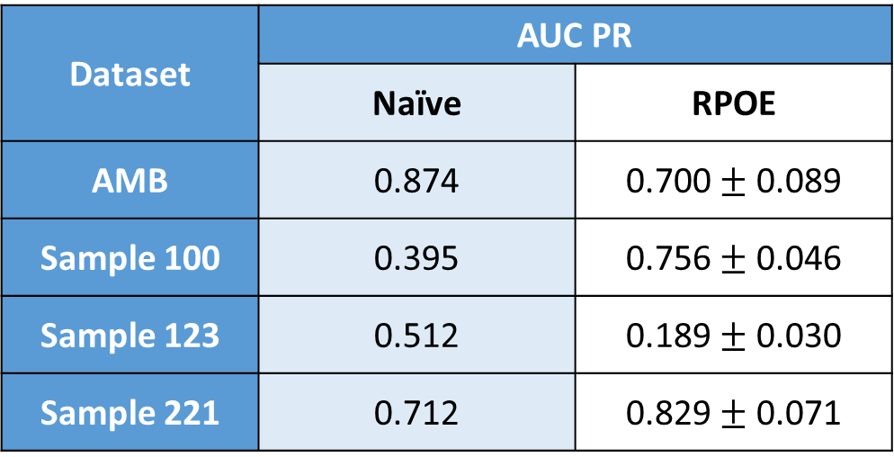
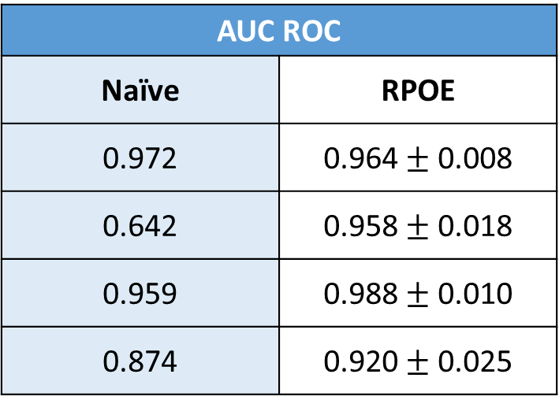
Results
Dataset | AUC PR
 | Naïve | RPOE
AMB | 0.874 | 0.700 $±$ 0.089
Sample 100 | 0.395 | 0.756 $±$ 0.046
Sample 123 | 0.512 | 0.189 $±$ 0.030
Sample 221 | 0.712 | 0.829 $±$ 0.071
AUC ROC
Naïve | RPOE
0.972 | 0.964 $±$ 0.008
0.642 | 0.958 $±$ 0.018
0.959 | 0.988 $±$ 0.010
0.874 | 0.920 $±$ 0.025
Simple 1D dataset!
1.5% outliers!
0.2% outliers!
AUC PR: Area under the Precision-Recall curve
Notes:
AMB dataset: already great results, difficult to beat! Simple dataset so naïve works better. Can out perform on more complex datasets. But for Sample 123, too little outliers (0.2%)

Slide 26

How the proposed method addresses the challenges
C1. Variety in outliers: Ensemble considers various views of data.
C2. Variety of input data: Diversity of base detectors, which also alleviates the need for hyperparameter tuning.
C3. Dependencies in time series: Windows.
C4. Noisy and finite dataset: RP and MP methods are reconstruction based, have lowest requirements on dataset size.
C5. High run-times: RP and MP are efficient, linear run-time.
C6. Supervision vs. accuracy: ….
... But initial results for semi-supervised approach is promising!
Notes:
High level of supervision needed due to conflicting results and many irrelevant features due to high parameter sensitivity and variety in detectors that detect different outliers.

Slide 27
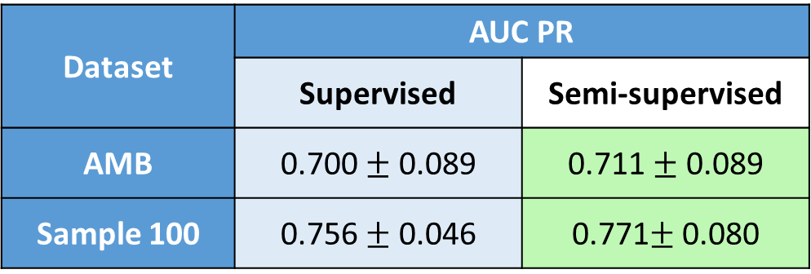
Semi-supervised attempt
Very primitive semi-supervised method.
Sampled 80% of labels and set remaining points as normal.
Dataset | AUC PR
 | Supervised | Semi-supervised
AMB | 0.700 $±$ 0.089 | 0.711 $±$ 0.089
Sample 100 | 0.756 $±$ 0.046 | 0.771$±$ 0.080
Notes:
Overfits less to the labels, can detect different outliers better.

Slide 28
Limitations
Future work
High level of supervision.
Many irrelevant components
WINNOW stopping criterion is based on accuracy
Limited evaluation
More sophisticated semi-supervised methods
Better definition of parameter sampling ranges, without user input
Test different performance metrics and aggregation algorithms
Use publicly available datasets, provide code, report PR AUC.

Slide 29
Conclusions
New approach using an ensemble.
Using ensemble methods is fairly new for outlier detection (Aggarwal, 2017).
Noteworthy run-time.
Results are competitive.
With semi-supervised and future work improvements it can potentially be great!
Field needs to work towards a more open science and report PR AUC.

Slide 30
References
Wu, H. S. (2017). A survey of research on anomaly detection for time series. 2016 13th International Computer Conference on Wavelet Active Media Technology and Information Processing, IC-CWAMTIP 2017, (1), 426–431. https://doi.org/10.1109/ICCWAMTIP.2016.8079887 Aggarwal, C. C. (2017). Outlier Analysis. https://doi.org/10.1007/978-3-319-47578-3

Slide 31
Questions?

Slide 32
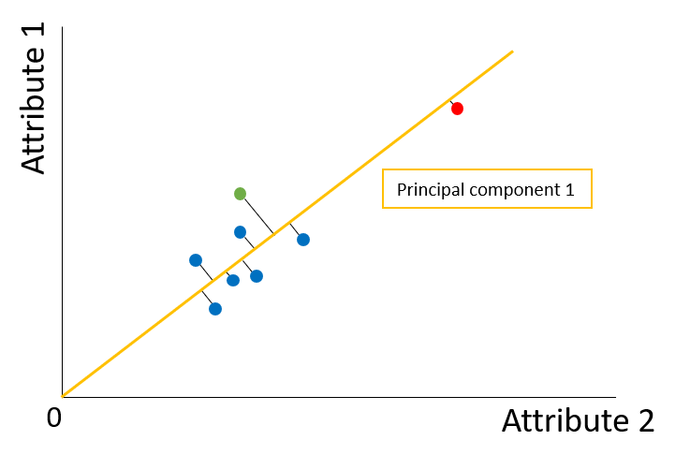
PCA Failure

Slide 33
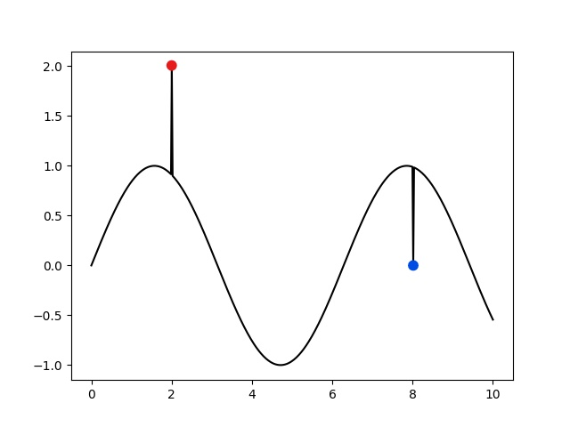
Types of outliers in univariate time series
Global and contextual additive outlier
Global collective outlier
Contextual collective outlier
Level shift

Slide 34

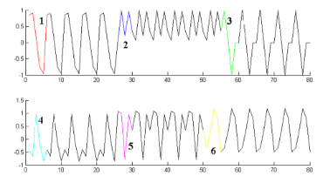

Types of outliers in multivariate time series
Spatial dependencies → can still be an outlier even if not in the individual time series.
Li et al, 2021.

Slide 35
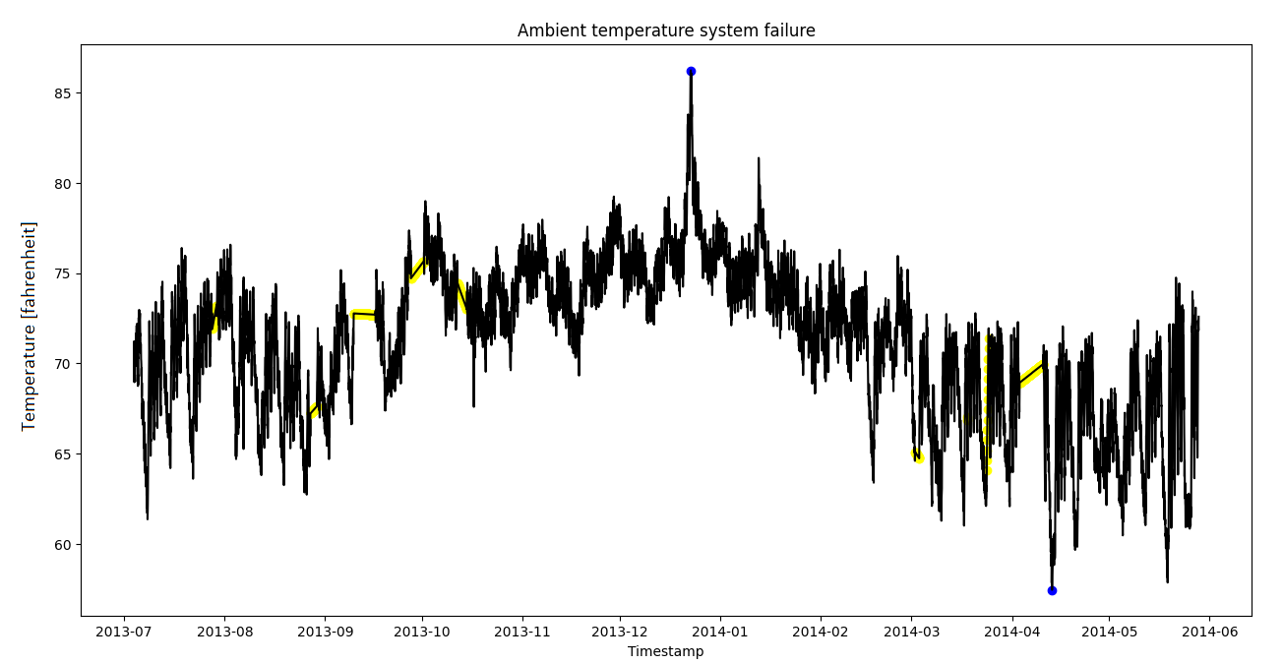
AMB Dataset

Slide 36
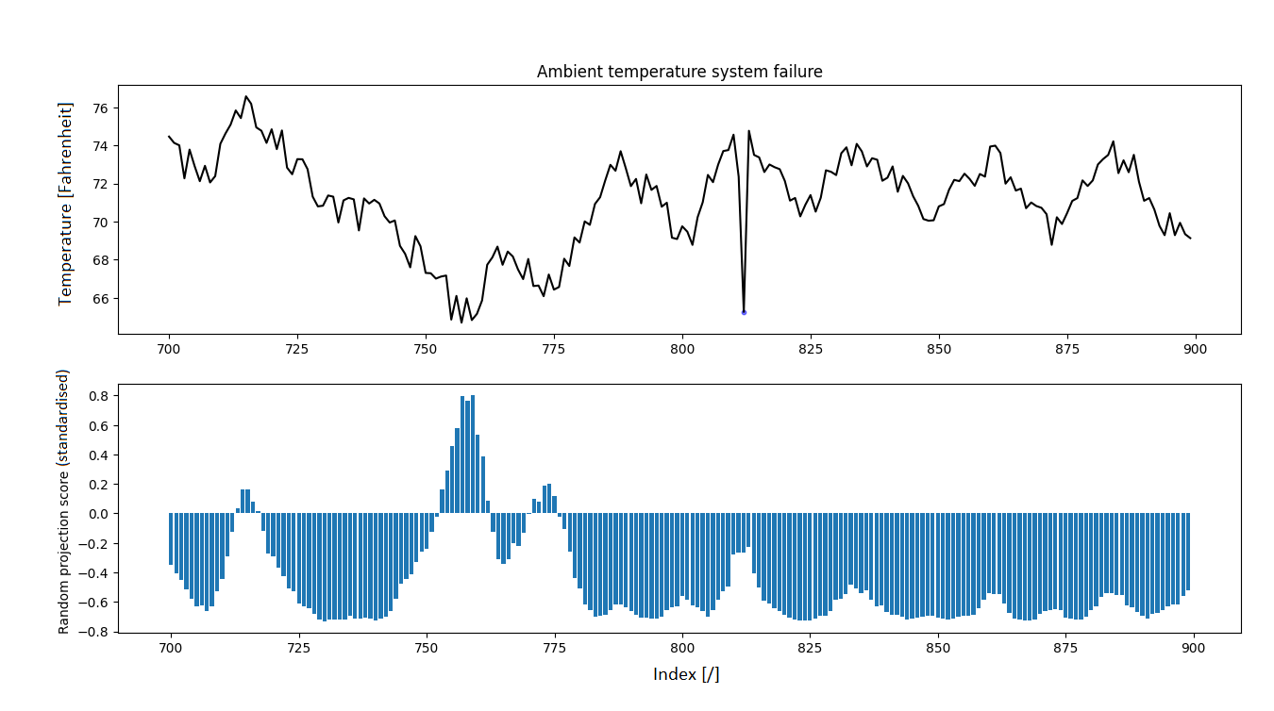
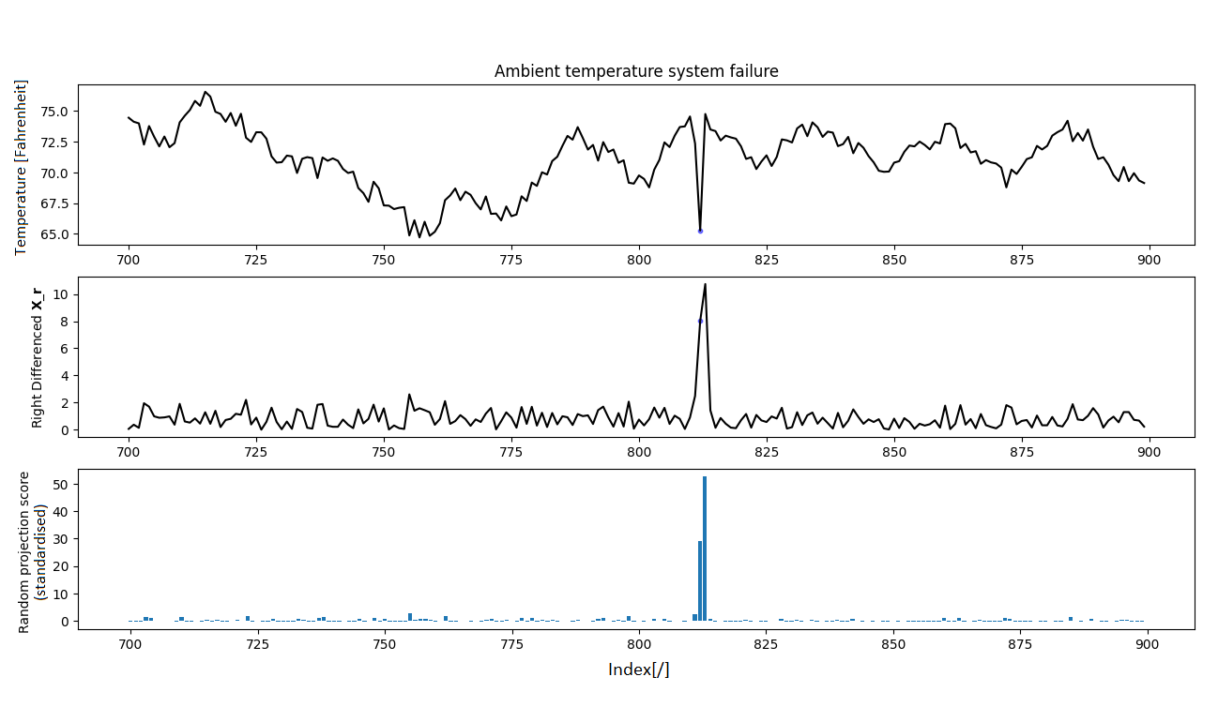
Why differencing?

